Slide 1
Neural Networks From Scratch
In Python

Slide 2
Progress
What is a neural network?
Uses of neural networks?
How do neural networks work?

Slide 3
What is a neural network?
A neural network is a from of Artificial Intelligence that is based of how the brain works with many neurones connected to each other.

Slide 4
Uses of a neural network
Neural networks have many uses, some of the more common are:
Classification
Prediction
Fraud Detection

Slide 5
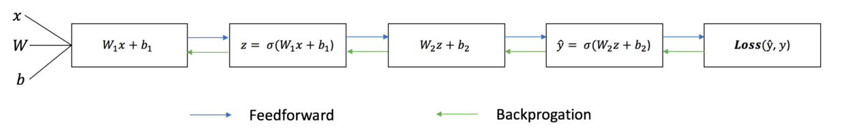
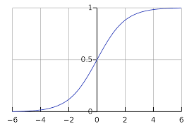
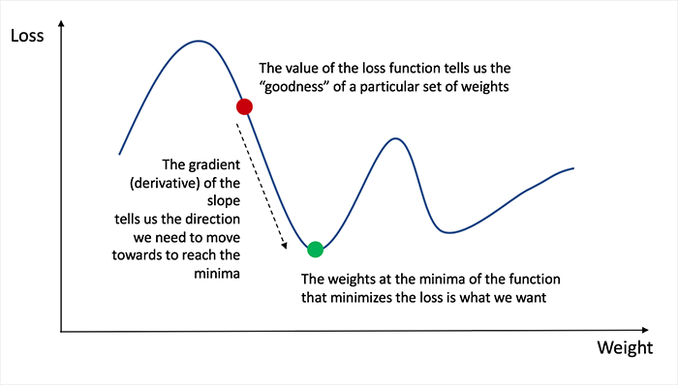



How do neural networks work?
$$σ=\frac{1}{1+e^{−x}}$$
$$\hat{y}=σ(W_{2}σ\left(W_{1}+b_{1}\right)+b_{2})$$
Biological process of learning.
Weights and bias.
Feed forwards.
Loss functions.
Back propagation.
Activation functions.
$$Loss= \sum_{i=1}^{n}{{(y−\hat{y})}^{2}}$$
Notes:
Put briefly, neural networks follow the biological process of learning, where a process occurs, and mistakes are learned from.
In the case of neural networks, each node has a unique weight and bias, (w, b), which are initially randomly chosen. The training data inputs are inputted during a process called “feed forward” and the outputs are compared with the expected outputs. The error is then calculated using loss functions and the weights and biases are altered using a process called “back propagation”.
Feed forward:
Feed forward is essentially basic calculus, and for a basic 2-layer neural network the output is [], where sigma is out activation function.
Loss function:
The loss function is a way of evaluating the accuracy of our neural network so that the weights and bias can be adjusted correctly during back propagation. There are multiple loss functions to be chosen from, one of the most simple being sum of squares error. It is the sum of the squared different between the output and the expected output in the training data.
Back propagation:
Once we have the error, we need to work backwards through the network and change the weights and bias. To calculate the appropriate amount to adjust the weights and bias, we need to know the derivative of the loss function with respect to the weights and bias, using the chain rule. The derivative tells us weather to increase the or decrease the weights and bias, as we want the loss to be at a minimum of the function, so we increase the weights and bias if the gradient is negative and decrease them if the gradient is positive.
Activation functions:
The activation function is vital to the success of the neural network. The output of the nodes is fed into the activation function before they are inputted into the next node. The main purpose of activation functions is to introduce non-linearity into the neural network, preventing them from becoming an over complicated linear regression. The sigmoid function transforms the input to a value between 0 and 1.
One of the more common ones is the sigmoid function.

Slide 6
Next Steps
Code
And write report etc…

